Slide 1
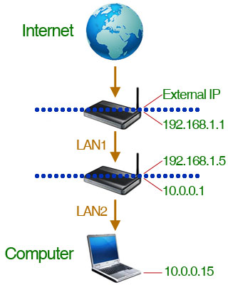
Presentation on IP Addressing
ABDUR RAZZAK
MCSA
Profession Diploma in Networking Technologies
BSc Hon’s and MSc in Mathematics
Mobile: 01723090660
Email: a.razzak660@gmail.com
Website: www.selftics.net

Slide 2
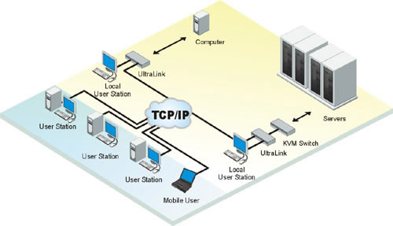
What is an IP Address?
An IP address is a numeric identifier assigned to each device (e.g. computer, printer) on a TCP/IP network.
It designates the specific location of a device on the network.
An IP address is a software address, not a hardware address.

Slide 3
IP Terminology
Bit: A bit is one digit, either a 1 or a 0.
Byte: A byte is 7 or 8 bits, depending on whether parity is used. For IP addressing, always assume a byte is 8 bits.
Octet: An octet, made up of 8 bits, is just an ordinary
8-bit binary number. The terms byte and octet are completely interchangeable.

Slide 4
IP Versions
Two versions of the Internet Protocol (IP) are in use: IP Version 4 and IP Version 6.
Each version defines an IP address differently. Because of its prevalence, the generic term IP address typically still refers to the addresses defined by IPv4.
IPv4: Internet Protocol version 4 (IPv4) is the fourth version of the Internet Protocol (IP). It is one of the core protocols of standards-based internetworking methods in the Internet. IPv4, which is only 32 bits long and represented in decimals.
IPv6: Internet Protocol version 6 (IPv6) is the sixth version of the Internet Protocol (IP). IPv6 addressing is not like IPv4 addressing. IPv6 addressing has much more address space and is 128 bits long, represented in hexadecimal.

Slide 5
IPv4 address
In IPv4 an address consists of 32 bits which limits the address space to 4294967296 (2³²) possible unique addresses.
IPv4 addresses are canonically represented in dot-decimal notation, which consists of four decimal numbers, each ranging from 0 to 255, separated by dots, e.g. 172.16.254.1.
Each part represents a group of 8 bits (octet) of the address.
In some cases of technical writing, IPv4 addresses may be presented in various hexadecimal, octal, or binary representations.

Slide 6
Network Address & Host Address
What is Network Address?
The network address—also called the network number—uniquely identifies each network.
Every machine on the same network shares that network address as part of its IP address.
In the IP address 172.16.30.56, for example, 172.16 is the network address.

Slide 7
Network Address & Host Address
What is Host Address?
The host address is assigned to, and uniquely identifies, each machine on a network.
This part of the address must be unique because it identifies a particular machine—an individual—as opposed to a network, which is a group.
In the sample IP address 172.16.30.56, the 30.56 is the host address.
The 172.0.0.1 address is used for Loopback or diagnostics.

Slide 8

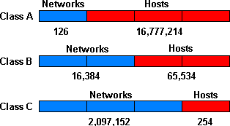
Class of IP address
Range of IP Classes
Class A | Range | 0.0.0.0 to 127.0.0.0 | Subnet mask: 255.0.0.0
Class B | Range | 128.0.0.0 to 191.0.0.0 | Subnet mask: 255.255.0.0
Class C | Range | 192.0.0.0 to 223.0.0.0 | Subnet mask: 255.255.255.0
Class D | Range | 224.0.0.0 to 239.0.0.0 | Reserve
Class E | Range | 240.0.0.0 to 255.0.0.0 | Reserve

Slide 9
Classes of Network
Class A Address: The IP range for a Class A network is 1 through 126. This provides 8 bits of network addressing and 24 bits of host addressing by default.
Class B Address: The IP range for a Class B network is 128 through 191. Class B addressing provides 16 bits of network addressing and 16 bits of host addressing by default.
Class C Address: The IP range for a Class C network is 192 through 223. Class C addressing provides 24 bits of network addressing and 8 bits of host addressing by default.
Class D Address: The IP range for a Class D network is 224 through 239. It is used for Multicast addresses.
Class E Address: The IP range for a Class E network is 240 through 255. It is used for Research (Scientific purposes).

Slide 10
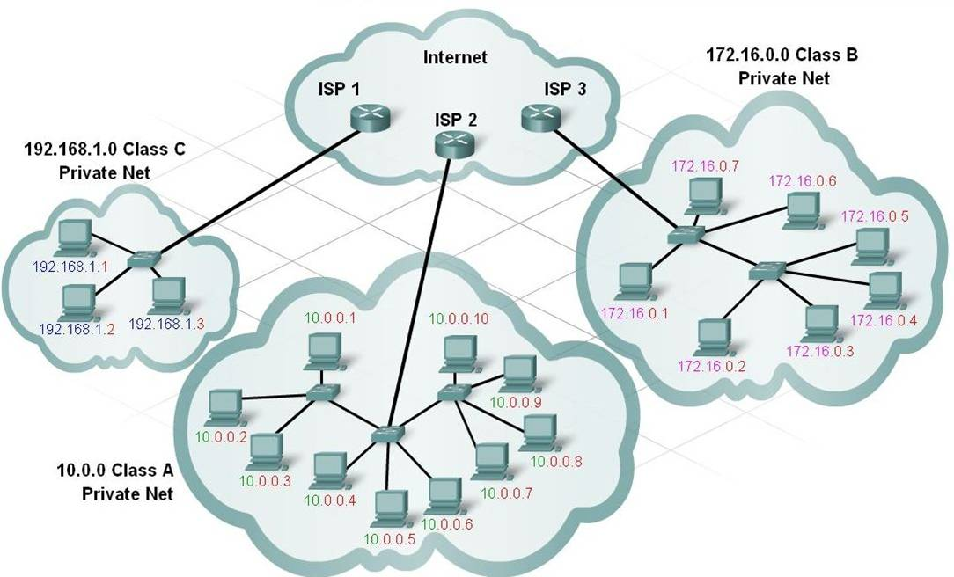
Class of Network

Slide 11
Classes of Network
IP Addressing in Binary
Class | 1st octet (8 bits) | 8 bits | 8 bits | 8 bits
A | Network | Host | Host | Host
B | Network | Network | Host | Host
C | Network | Network | Network | Host
A | 0xxxxxxx | xxxxxxxx | xxxxxxxx | xxxxxxxx
B | 10xxxxxx | xxxxxxxx | xxxxxxxx | xxxxxxxx
C | 110xxxxx | xxxxxxxx | xxxxxxxx | xxxxxxxx
Class | 1st octet range | In Decimal | Example
A | 00000001-01111111 | 1-127 | 10.1.0.1
B | 10000000-10111111 | 128-191 | 150.1.1.10
C | 11000000-11011111 | 192-223 | 200.1.1.15

Slide 12
Subnet Mask
A Subnet mask is a 32-bit number that masks an IP address, and divides the IP address into network address and host address.
Subnet Mask is made by setting network bits to all "1"s and setting host bits to all "0"s.
Class | Format | Default Subnet Mask
A | Network.Host.Host.Host | 255.0.0.0
B | Network.Network.Host.Host | 255.255.0.0
C | Network.Network.Network.Host | 255.255.255.0

Slide 13
Network address and Broadcast address
Network address: This is the designation used in routing to send packets to a remote network.
For example- 10.0.0.0, 172.16.0.0, and 192.168.10.0 etc.
Broadcast address: The broadcast address is used by applications and hosts to send information to all hosts on a network.
For example- 10.255.255.255, 172.16.255.255, and 255.255.255.255 etc.

Slide 14
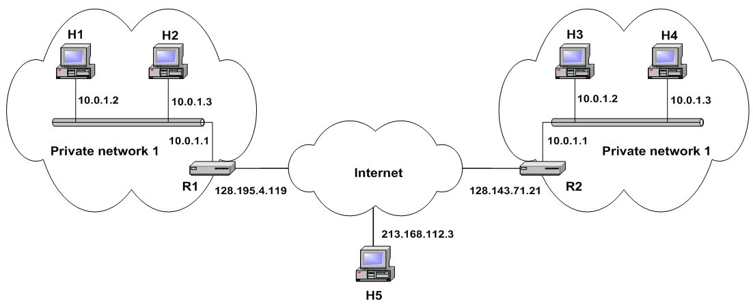
Private (Reserved) IP Addresses
Class A Private IP address range is 10.0.0.0 through 10.255.255.255
Class B Private IP address range is 172.16.0.0 through 172.31.255.255
Class C Private IP address range is 192.168.0.0 through 192.168.255.255
The APIPA address range is 169.254.0.1 through 169.254.255.254

Slide 15
IP Subnetting and Classless IP Addressing
Subnetting:
The practice of dividing a network into two or more networks is called subnetting.
Classless Inter-Domain Routing (CIDR):
Classless Inter-Domain Routing (CIDR) is a way to allow more flexible allocation of IP addresses than was possible with the original system of IP address classes.
IP subnetworks
IP networks may be divided into subnetworks in both IPv4 and IPv6. For this purpose, an IP address is logically recognized as consisting of two parts: the network prefix and the host identifier.
The subnet mask or the CIDR prefix determines how the IP address is divided into network and host parts.

Slide 16
The End…
Thanks for watching the presentation…

